Slide 1
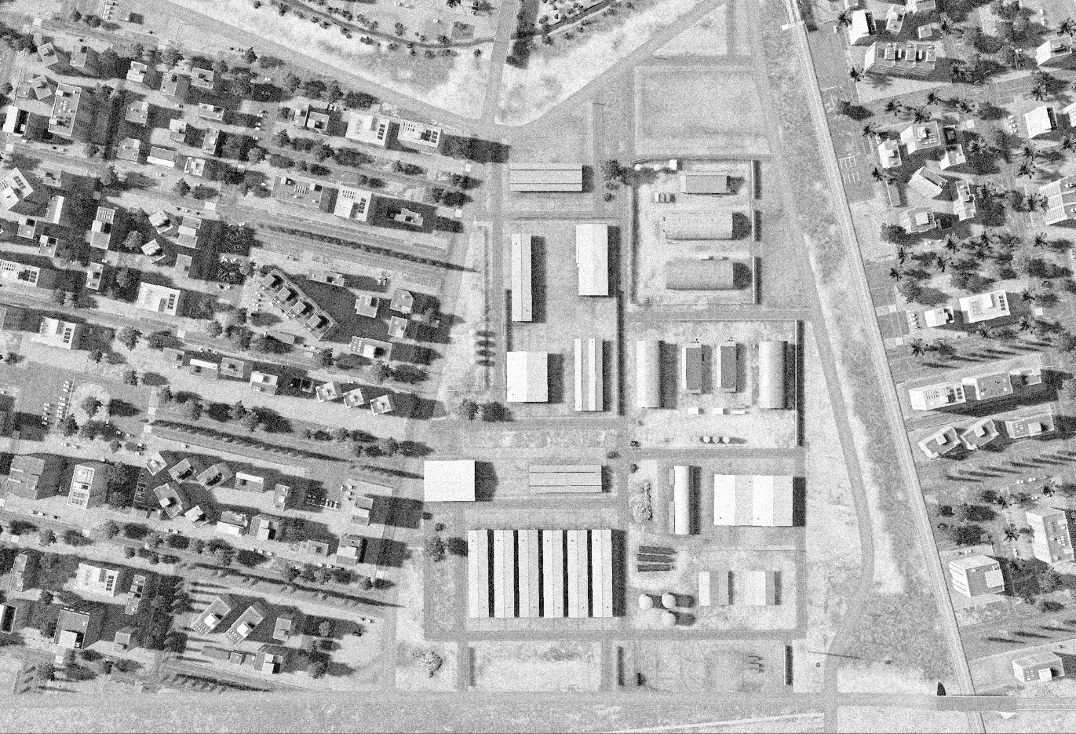
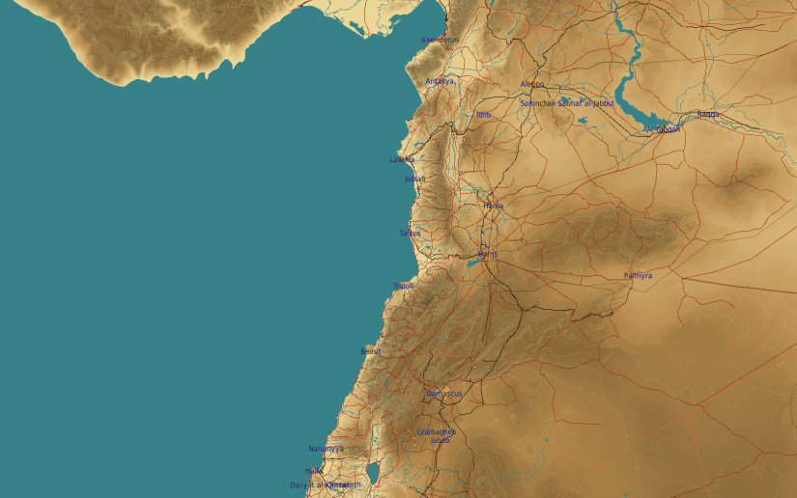
OPARTGT025 TARTUS VEHICLE FACTORY
N
25
8
7
1
2
3
4
DESIRED POINT of IMPACT:
DPI 8 - N34 52.380 E 35 53.710 / 28ft / 2000lb PGM
DPI 7 - N34 52.363 E 35 53.710 / 28ft / 2000lb PGM
DPI 6 - N34 52.286 E 35 53.742 / 33ft / 2000lb PGM
DPI 5 - N34 52.286 E 35 53.726 / 33ft / 2000lb PGM
DPI 4 - N34 52.330 E 35 53.742 / 30ft / 2000lb PGM
DPI 3 - N34 52.330 E 35 53.623 / 30ft / 2000lb PGM
DPI 2 - N34 52.330 E 35 53.708 / 30ft / 2000lb PGM
DPI 1 - N34 52.329 E 35 53.692 / 30ft / 2000lb PGM
5
6
CDC - High density civilian housing within 50m of facility. Chemical storage tanks (in red) pose high pollution risk to civilian population. Tartus military hospital campus within 200m to the west of facility.

